Slide 1
Laravel Certification Course
AYUSH SELADIA 23000046
SYBCA - B

Slide 2
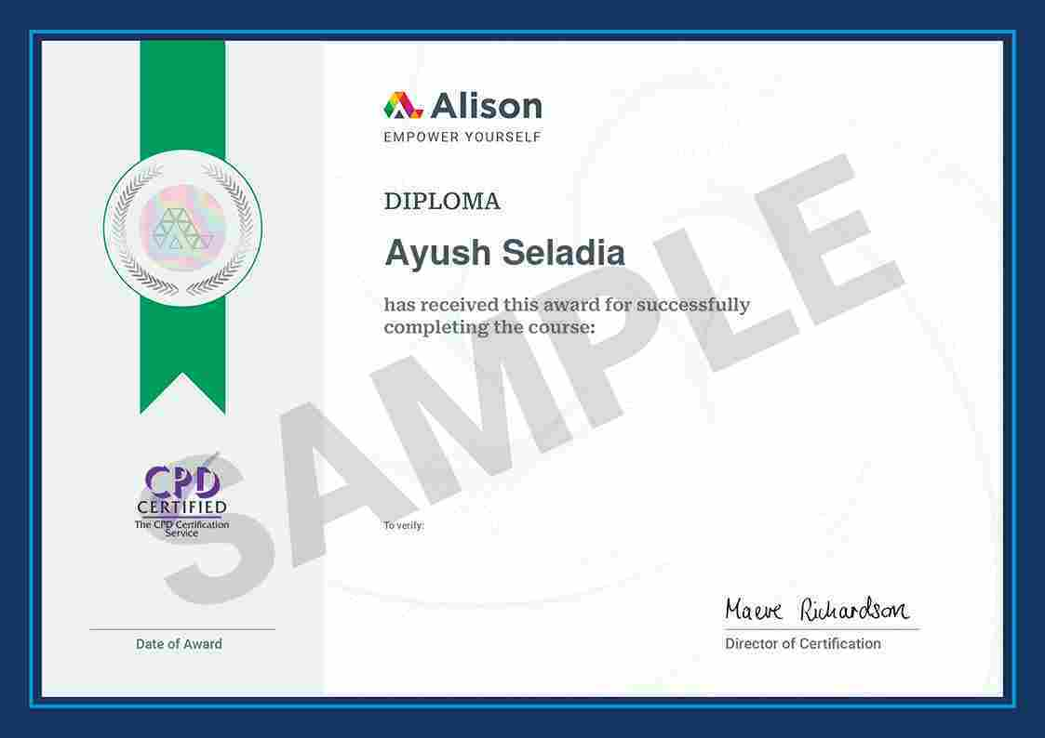
Course Completion Certificate

Slide 3
CONTENTS
01
02
Introduction to Laravel
Understanding MVC in Laravel
03
04
Practical Implementation of MVC
Developing a Simple Web Application
05
06
Advanced Laravel Features
Conclusion and Next Steps

Slide 4
Introduction to Laravel
01
.

Slide 5
What is Laravel?
Purpose of Laravel
Strengths of the Framework
Key Features
Laravel includes essential features like routing, authentication, caching, and session management, simplifying the development process and encouraging developers to innovate without unnecessary overhead.
Laravel aims to streamline web development by providing an elegant syntax that reduces the complexity of routine tasks, allowing developers to focus on application-specific features.
The framework equips developers with a rich repository of pre-built components and libraries, enabling rapid application construction without the need for building everything from scratch.

Slide 6
Advantages of Using Laravel
01
02
03
Scalability and Maintainability
Extensive Ecosystem
Community Support
Following the MVC architectural pattern, Laravel promotes a clear separation of concerns, facilitating easy code organization and making applications scalable and maintainable as they grow.
Laravel boasts a vast ecosystem with numerous packages and bundles that extend functionality, covering various needs and enabling easier integration of existing solutions.
A vibrant community accompanies Laravel, providing extensive documentation, forums, tutorials, and resources to help developers find solutions and stay updated.

Slide 7
Understanding MVC in Laravel
02
.

Slide 8
Significance of MVC
Separation of Concerns
Benefits of Code Reusability
The MVC architecture enhances code organization by clearly delineating responsibilities: Models for data management, Views for presentation, and Controllers for application flow.
Each MVC component can be developed and reused independently, optimizing efficiency by reducing code duplication across different parts of the application.
Impact on Scalability
Separating components allows for easier maintenance and scaling; changes in one aspect do not adversely affect others, ensuring stable performance during updates.

Slide 9


Testing Support
Unit Testing Advantages
Enhanced Development Process
The clear separation within MVC facilitates unit testing, allowing developers to validate each component individually—ensuring that Models, Views, and Controllers function as intended.
By following MVC best practices, developers can create structured and maintainable applications that promote effective development workflows and quality assurance.

Slide 10
Practical Implementation of MVC
03
.

Slide 11
Examples of MVC Components
Model Implementation
View Creation
Controller Functionality
01
02
03
In Laravel, a Model is represented using Eloquent ORM, allowing for easy data manipulation. For example, the User Model can define relationships with other entities, enhancing data interaction.
Views in Laravel are created using Blade templating engine, which provides a clean syntax for rendering dynamic content. For example, user profiles can be displayed by directly embedding PHP variables within HTML.
Controllers manage the application’s logic by connecting Models and Views. They process incoming requests, perform necessary data retrieval or manipulation, and return the appropriate response to the user.

Slide 12
Developing a Simple Web Application
04
.

Slide 13
Setting Up Laravel
02
Setting up Laravel…….
Configuration
After installation, configure environment settings in the `.env` file where you can set database connections and application-specific configurations for seamless development.
01
Installation Steps
To begin a Laravel project, first ensure PHP and Composer are installed. Create a new project via Composer, setting up the directory structure and configuration required for initial development.

Slide 14
Building Components
Creating Models
Use Artisan commands to create Models that represent database entities. Customize these Models with relationships and validations to ensure they align with your data architecture.
02
Crafting Views
Develop Views using Blade templates, implementing layouts and sections to organize content. This structured approach enhances reusability and consistency across your application’s interface.
01

Slide 15
Advanced Laravel Features
05
.

Slide 16
Eloquent ORM
Database Interactions
Eloquent ORM simplifies database interactions through an expressive interface. Developers can perform complex queries using chainable methods, improving readability and maintenance.
Relationships Management
Eloquent allows defining various types of relationships (one-to-many, many-to-many, etc.), making database management intuitive and efficient for representing data relationships.

Slide 17
Artisan CLI
02
Artisan CLI…….
Custom Commands
Developers can create custom Artisan commands tailored to specific tasks, improving efficiency and maintaining organized workflows within the development process.
01
Automating Tasks
Artisan CLI is Laravel's command-line interface that facilitates the automation of repetitive tasks. It provides numerous commands for database migrations, testing, and running scheduled jobs.

Slide 18
Conclusion and Next Steps
06
.

Slide 19
Recap of Laravel Benefits
Streamlined Development
Laravel's elegant syntax, modern tooling, and extensive ecosystem drastically streamline the web development process, making it efficient and enjoyable for developers.
Continuous Learning
Engaging with Laravel's wealth of documentation, community, and best practices encourages continuous improvement and adaptation in a fast-evolving web development landscape.

Slide 20
Future Learning Paths
Advanced Topics
Consider exploring advanced topics such as API development, package creation, and complex relationship handling within Eloquent to further enhance your Laravel expertise.
Community Engagement
Participating in community forums, attending Laravel meetups, and contributing to open-source projects can enrich your knowledge and networking opportunities in the Laravel ecosystem.

Slide 21
THANK YOU

